Slide 1
Analysis Discussion

Slide 2
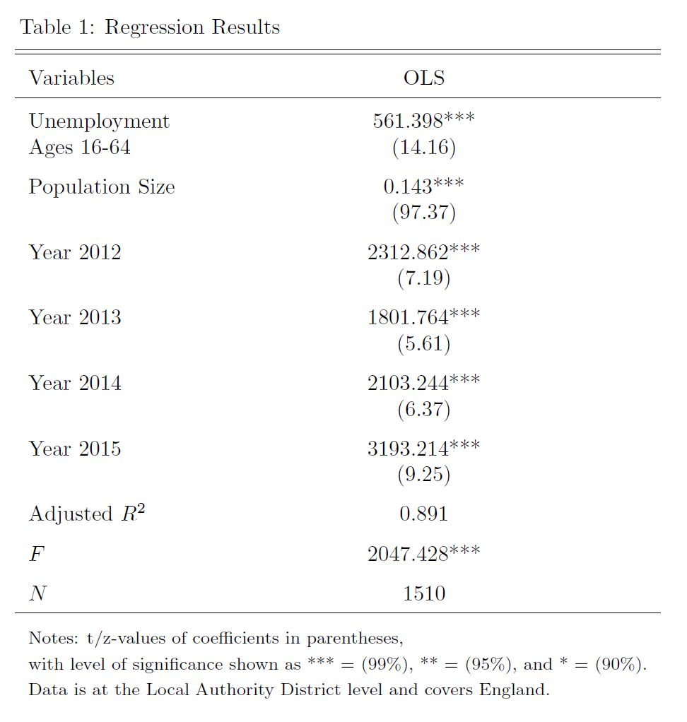
Notes:
Our statistical analysis of the data was fairly simple, as much of our effort went towards wrangling the data and then using it to generate map visualizations and descriptive statistics, some of which you’ve seen already. For our statistical analysis we wanted to see if we could successfully predict the number of crimes in a local authority district using the demographic and economic indicators that we found. In particular, we tried to predict the number of crimes using unemployment between economically active members of the local authority district between the ages of 16 and 64. In order to control for at least one obvious source of variability in total crime, we also included population of the local authority districts as a predictor.
The method that we applied is the ordinary least squares linear regression technique.
Finally, we included a dummy variable for each year of the data that we used except for 2011. We are not naïve enough to believe that the only predictor of total crime is going to be unemployment, though we do believe it makes methodological sense for it to be one of the strongest. As such, including a Year dummy variable for each year helps us to approximately control for various economic factors that were not readily available, such as yearly mean or median household income, or GDP. I say that it would approximately control for those things because in their absence, the dummy variable for year is going to be given credit by the regression for variation that is actually caused by these missing macro-economic indicators changing between years.
Now I have introduced all 6 of the predictors that we used to predict total crime. As you can see, all of the predictors were statistically significant at a 99% confidence level, and the adjusted R^2 was 0.891, indicating that these 6 predictors can, together, explain approximately 89.1% of the variation in total crimes across local authority districts. It is clear that the model has explanatory power as indicated by the F statistic. There were 1510 records in the regression. That is one record per year per local authority district between 2011 and 2015. There were about 150 records that had to be removed prior to running the regression due to missing data.
I will speak more about these predictors and their significance as we move forward.

Slide 3
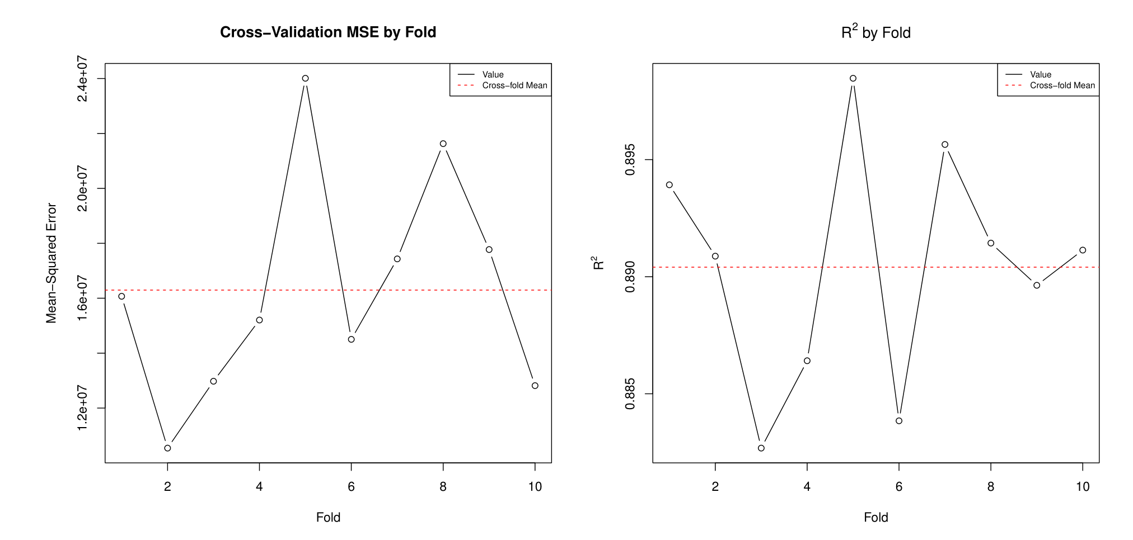
Notes:
In order to perform validation on our analysis, we used 10-fold cross-validation.
Here you can see the results of 10-fold cross validation on our regression analysis. On the left you can see our mean-squared error, which is pretty high, just above 16 million. This indicates that, if we were to use this model to perform prediction, the predictions would be off, on average, by about 4000 crimes. For larger predictions that isn’t so bad, but the mean value of total crime in our data is 14280 and the median is just under 10,000. As a result, we would have to say that you would not want to use this model for prediction.
You might think that this is odd and unexpected given the graph on the right of R^2, which indicates that on average we explain approximately 90% of the variation in the data. Although the model can explain that, and indicates that the variables we included are relevant in the prediction of total crime, it also points to the other problem that I’ve already alluded to, which is omitted variable bias, which will be a theme as we continue to look at the cross-validation results and analyze this model.

Slide 4
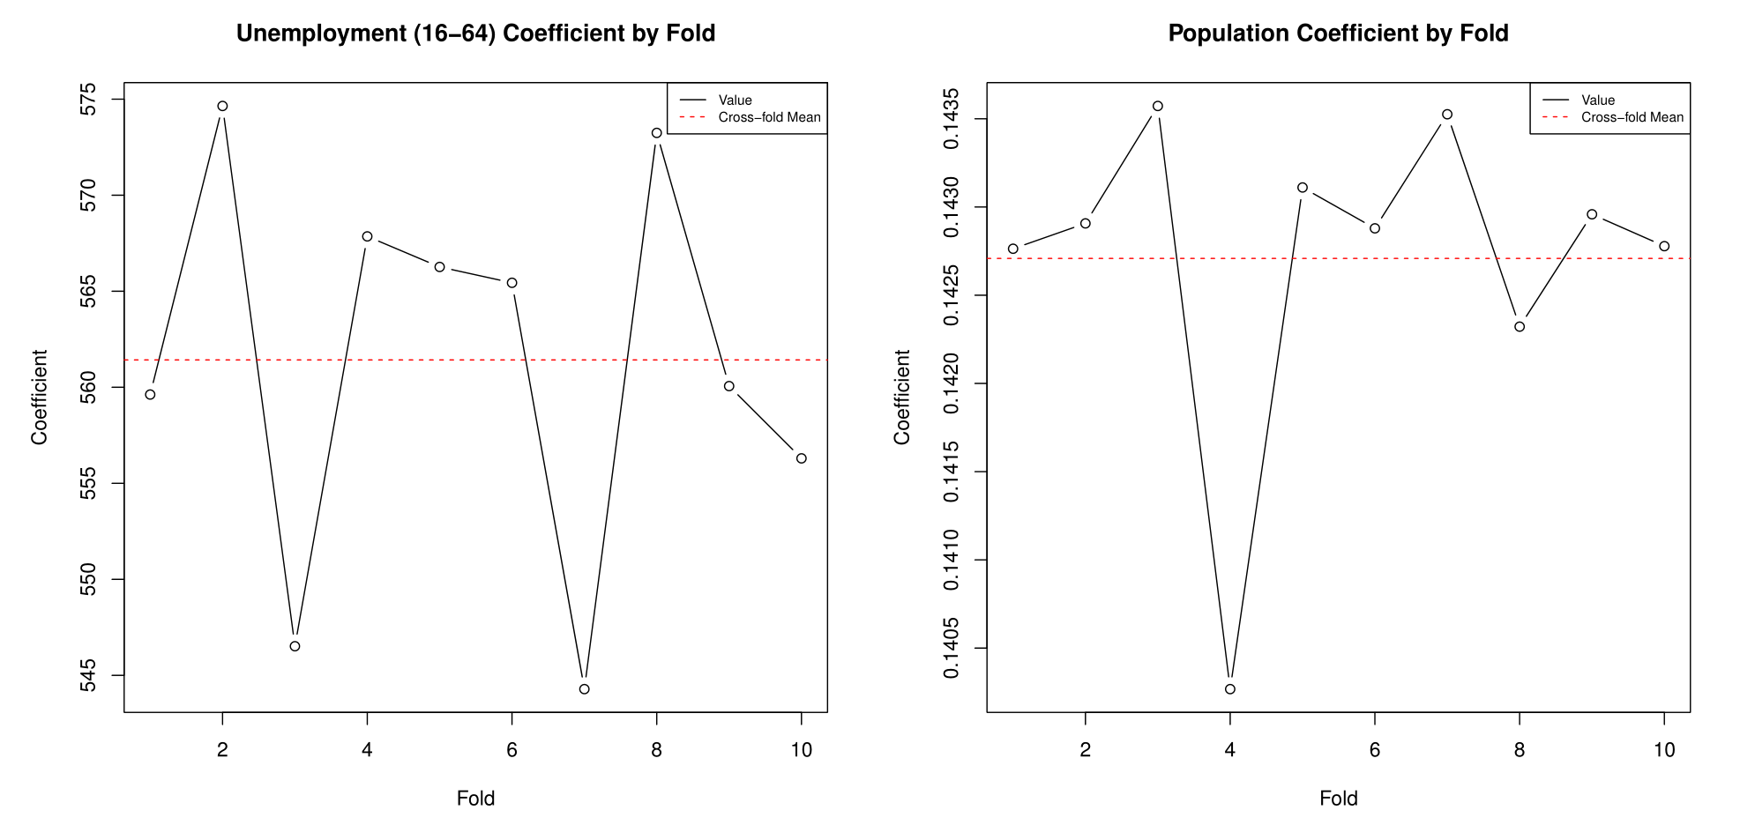
Notes:
We were very happy with the stability of our model, and I am indicating it here by showing the coefficients for unemployment and population that were applied for each fold. Note that although the graphs look relatively variable, the scale on the y-axis is very small.
Note that our average coefficient for Unemployment was approximately 562, indicating that for each additional 1% of economically active 16 to 64 year olds that are unemployed, there will be, on average, 562 more crimes.
The coefficient for Population indicates that, ceteris paribus, we would expect another crime for every 7 people in the local authority district. Recall that “crimes” are loosely defined here, as “anti-social behavior” is the most common crime in our data.

Slide 5
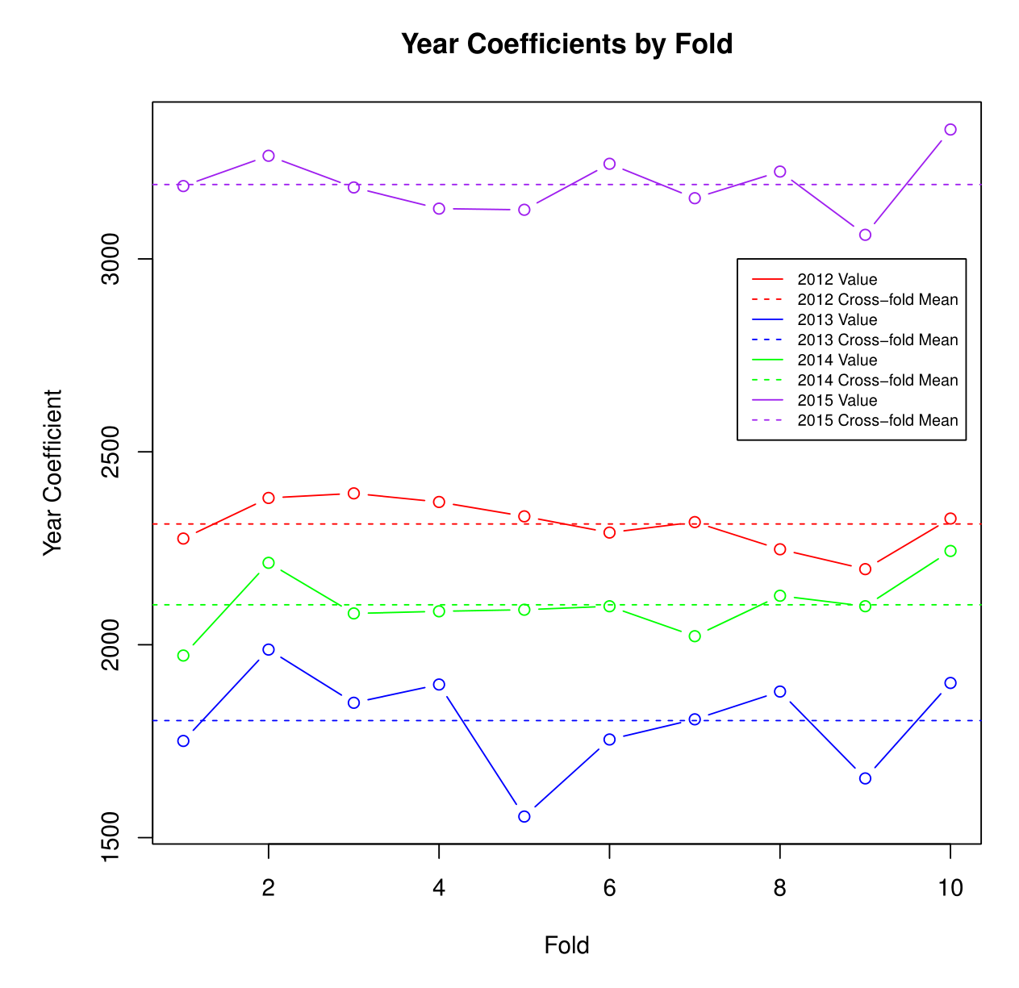
Notes:
Finally, we can take a look at the variance of the coefficients across years and within year across folds. Again, these values are very stable. Recall that these have to be considered in relation to 2011. So if 2011 is considered the baseline, then we could interpret the 2012 year coefficient on the first fold to mean that on average, in 2012 there are roughly 2300 more crimes than there were in 2011.
Unfortunately, with such high magnitudes and a non-trivial variance, since we have no methodological reason to believe that one year should be so different from the others, we can put the nail in the coffin of the omitted variable bias theory. The year variable is clearly acting as a proxy for other variables that should have been included in the regression, were they available, but are not. Given the large magnitude of these coefficients and the high variance among them, we would need to be even more careful about predicting values outside of the time range of our data than we are with predictions without our time range.

